Slide 1
LCA Modelling with SimaPro Online Platform

Slide 2
Preparing for your course
Thank you for choosing the SimaPro online platform for teaching LCA.
We put this document together to help you prepare for your course.
This way you should have a better idea of what to expect and ensure a smooth start for your students!
Notes:
How often to touch base?

Slide 3
Checklist | Lecturer
Things to consider:
Learning objectives and which modules will be needed to fulfill this objective. For example:
Full LCA → Use
Comparison of products → Use
Individual and/or group work?
How many students in the course?
Which data libraries do you need?
Which impact assessment methods do you need?

Slide 4
Checklist | Lecturer
Also good to check the technical side of things:
Your company is created on platform with a sufficient number of users
You have ‘Company Admin’ role under ‘User settings’
Students are added to your company (see instructions on next slide)

Slide 5
Creating student accounts (1/2)
If you want to have a training or start with many users on the platform you can use the bulk upload feature. This allow you to create multiple users and assign them the necessary access rights in one go. To do that:
DOWNLOAD the Excel file with the structure seen in the table:
Fill in the file with:
Names and email addresses of the users you want to create. The email address will become the login username.
Modules (Collect, Flow and/or Share) which you want them to have access to. For all the modules a 1 means that they will have an expert access to this module and will be able to see and edit all the unhidden/unlocked projects in the company and the module (Flow, Share, Collect) you assign them to. For example if you want checkB to create Flow model and create scenarios in Share, then fill in 0 for Collect and 1 for Flow and 1 for Share.
Name | Email | Collect | Flow | Share | End date | Remove
checkA | checka@pre.nl | 0 | 0 | 0 | 10/30/2018 | 0
checkB | checkb@pre.nl | 0 | 1 | 1 | 10/30/2019 | 0
checkC | checkc@pre.nl | 1 | 0 | 0 | 10/30/2019 | 0
checkD | checkd@pre.nl | 1 | 0 | 0 | 10/30/2019 | 0

Slide 6
Creating student accounts (2/2)
An end date for each user. The start date will be the upload date, this will also be when they can start logging in.
Remove, should be left with zero. If this is 1 the user will be removed from the company or not created in the first place.
Login to apps.simapro.com/
Go to Flow, Click Add new project or open an existing project. The upload does not affect any existing projects.
Upload the file you created by dropping your file or click Import and browse. Note! The file should remain in .xlsx format.
The users will be created and a report will be generated confirming the user creation. From now on the users can log in themselves.
Some things to keep in mind:
The users you created have to request a new password the first time they want to login.
The email address used in the excel file will be their username and the reset password email will be sent to this address.
If a user already exists they will not be added and the role will not be edited.

Slide 7
Checklist | Student
Before the course starts, check that you:
Can login and access https://apps.simapro.com (you will be required to request a new password)
Have the correct permissions and access to modules (for example, only Flow or also Share)

Slide 8
Resources & Support
Lecturer/ Professor can contact SimaPro Support at:
support@simapro.com
+31-33-4504010
Step-by-step tutorials:
Flow Tutorial
SimaPro 9 tutorial
Introduction to LCA
Quick-start guides:
Getting started with Flow
Getting started with Share
Getting started with Collect (if relevant)
In-tool help
Platform offers tours which will start when you enter the
spaces. Or click on
Many more other resources at support.simapro.com!
Notes:
NOTE: some materials may contain some outdated screenshots as we recently changed the SimaPro branding – we are in the process of updating all materials

Slide 9
Quick start guide
Notes:
Login at https://apps.simapro.com

Slide 10
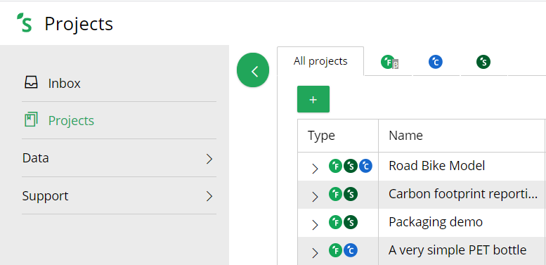
Start by creating a Flow project
Go to https://apps.simapro.com/ to create a new project

Slide 11
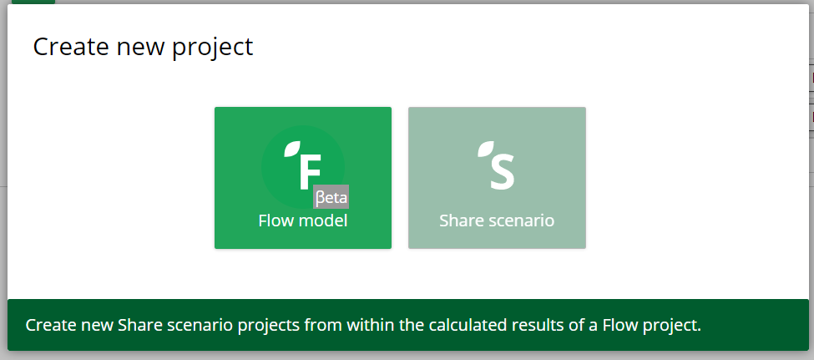
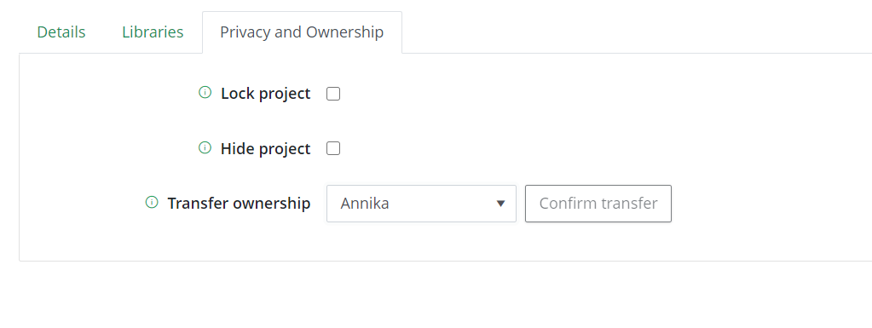
Start by creating a Flow project
Select Flow Enter project details and select the libraries you want to use.
Under ‘Privacy and Ownership’ select ‘Lock project’
Notes:
Lock project: project is visible to other students, lecturers but cannot be edited
Hide project: project is hidden from all other students, lecturers
Ownership can also be transferred from one student to another

Slide 12
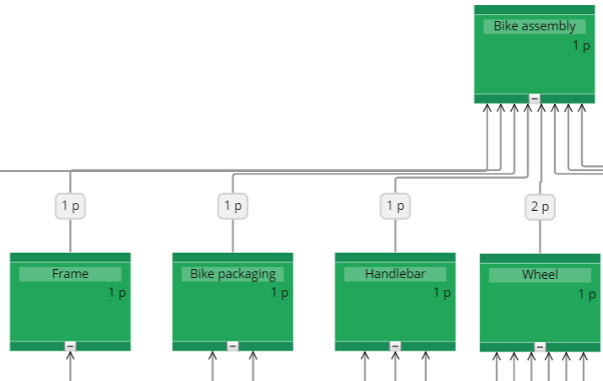
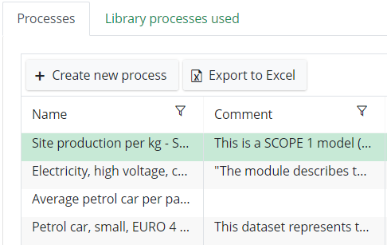
Flow enables two ways of modelling
Canvas Set up your basic model in seconds, even before you have your LCI data
Visual modelling
Ability to add inputs
Manage processes Ideal for detailed modelling and linking to reference data
Ability to add library processes
Ability to add inputs/outputs/substances
Link to Collect surveys (if relevant)
Notes:
You start ‘sketching’ using the Canvas and then fill in the library data using the Processes

Slide 13
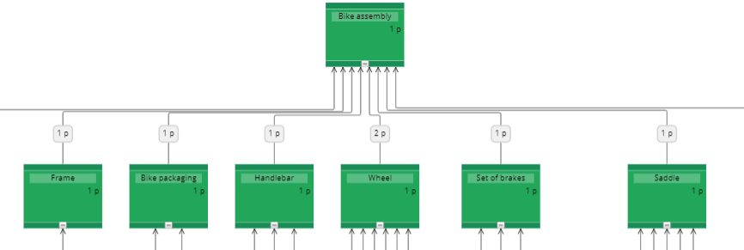
In the canvas you can start creating a network
Amounts and quantities can be specified later

Slide 14
The canvas displays nodes and flows
A process produces a certain amount of an output product. Together they form a node
You can refer to either one of these when naming your node
Inputs required by this node are displayed as flows
“To produce 40 boxes of lemonade,
we need 4 kg cardboard,
800 litres of lemonade
and 1600 plastic bottles”

Slide 15
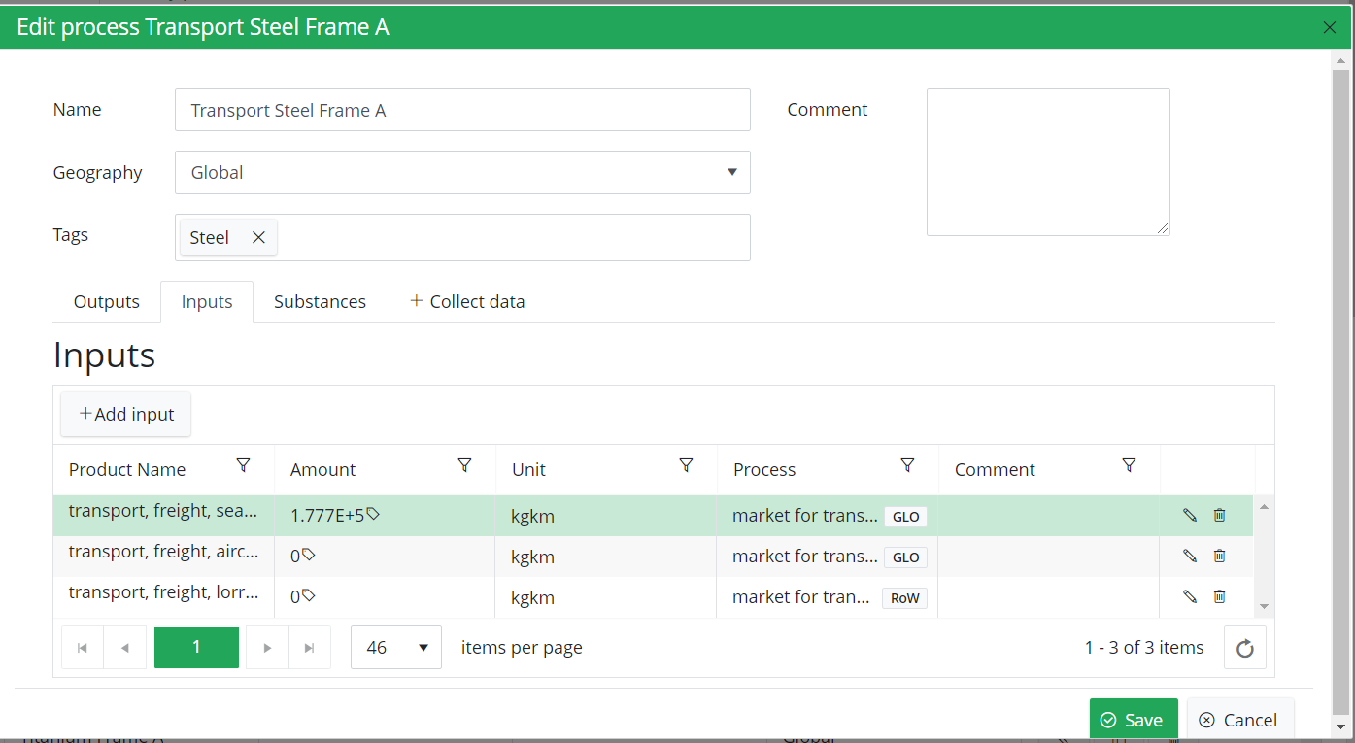
Detailed modelling
Each process must have at least 1 output flow
Under inputs, you can add processes from other libraries like ecoinvent
Under substances you can add intervention flows to and from nature
Notes:
REPLACE WITH PROCESS RECORD

Slide 16
Parameters
Enter a parameter name or calculated expression in any amount field in Flow
Known parameters will automatically be recognized
New parameters will automatically be created with a value of 1
Parameters can be edited (or also created) from the parameters screen
The parameters screen also has a handy “Used by” button for checking where the parameters are used in your model

Slide 17
Calculating impacts
Select a process, impact assessment method and calculate
Use Analysis groups to change how the results are displayed (for example – by production stage instead of by component)
Can only save 1 default calculation setup

Slide 18
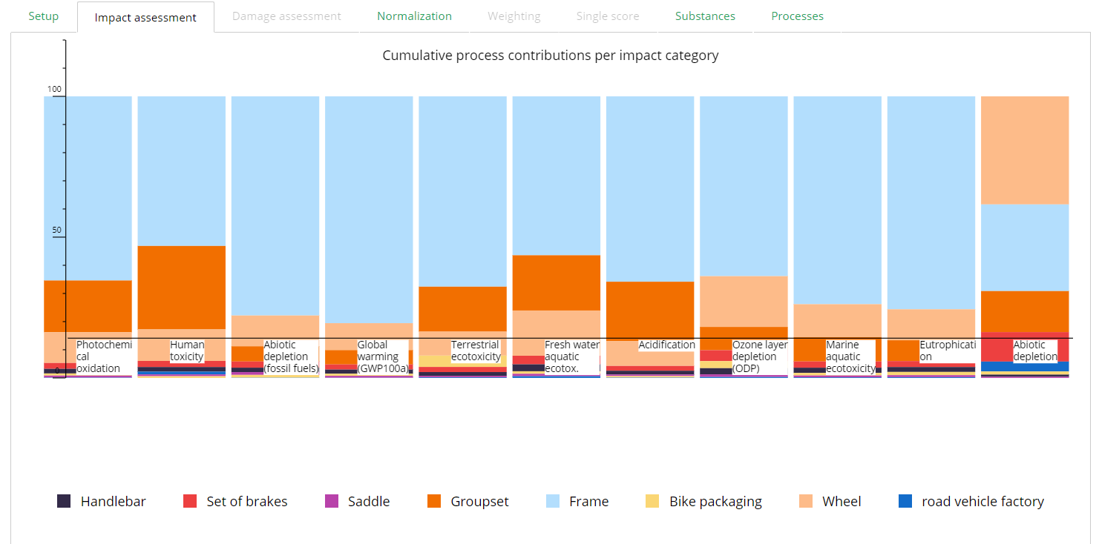
Impact Assessment
Notes:
Example – available impact assessment options depends on choice of method

Slide 19
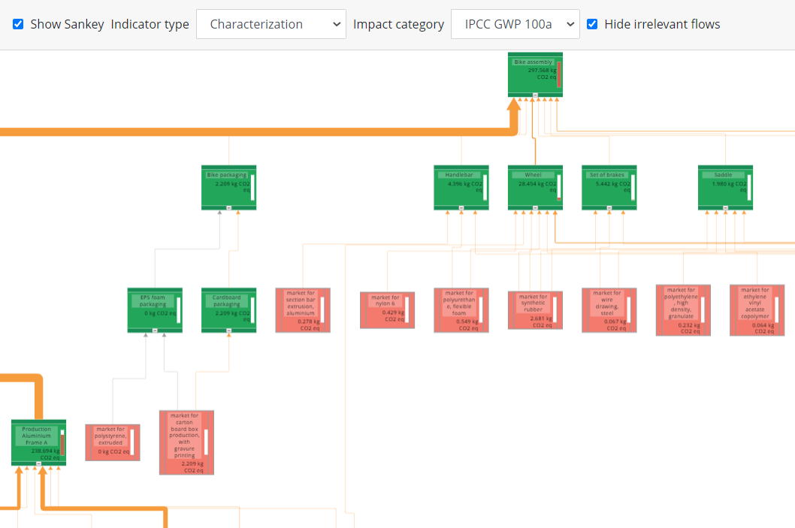
After calculating – go back to canvas for Sankey
Powerful visualization of how impacts propagate through the system

Slide 20
Time for you to use the platform!

